Slide 1
A Brief Story of Computing on Private Data
Ten H Lai
Ohio State University

Slide 2
Agenda
Computing on private data
Fully homomorphic encryption (FHE)
Gentry’s bootstrapping theorem
Our result

Slide 3
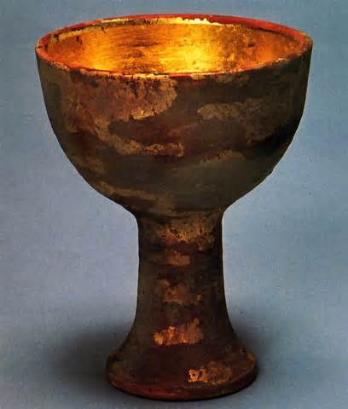
FHE: The Holy Grail of Cryptography

Slide 4





Cloud Computing
Servers
Storages
Networks
Applications

Slide 5




天上有多少星星
城裡有多少姑娘
但人間只有一個妳
天上只有一顆月亮

Slide 6






Cloud Computing
Encrypt
Cloud
server
Internet

Slide 7
Computing on private data
Encrypt
Cloud
server
Internet

Slide 8
Computing on private data
Cloud
A question proposed by Rivest, Aldeman, Dertouzos in 1978 (one year after RSA was invented).

Slide 9
C-Homomorphism

Slide 10
C-homomorphic

Slide 11
RSA is multiplicatively homomorphic

Slide 12
Fully Homomorphic Encryption (FHE)

Slide 18
Bootstrapping

Slide 19
Evaluate
Decrypt
sk_{A}
Decrypt
m
m
m
m encrypted under a pink key pk_{A}

Slide 20
Evaluate
Decrypt
sk_{A}
Decrypt
m
m
Encrypt under a blue key pk_{B}
sk_{A}
Evaluate
Decrypt
m
m

Slide 21
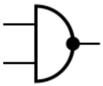
NAND-augmented Decrypt circuit:
sk_{A}
sk_{A}
Decrypt
NAND
m₁
m₁ NAND m₂
Decrypt
m₂

Slide 22
Evaluate
sk_{A}
c₁
sk_{A}
c₂
Decrypt
NAND
m₁
m₁ NAND m₂
Decrypt
fresh
m₂

Slide 23
Under a pink key PK_{A}
Under a blue key PK_{B}
m₁
m₁ NAND m₂
m₂
fresh
sk_{A}
23

Slide 24
m₁
m₁ NAND m₂
m₂
Increased noise
24

Slide 25
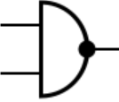

Slide 26
sk_{A}
m₁
m₂
Evaluate
Decrypt-NAND
m₁ NAND m₂
m₁ NAND m₂
(m₁ NAND m₂) NAND (m₃ NAND m₄)
sk_{B}
Evaluate
Decrypt-NAND
sk_{A}
m₃
m₄
Evaluate
Decrypt-NAND
m₃ NAND m₄
m₃ NAND m₄

Slide 27
sk_{A}
m₁
m₂
Evaluate
Decrypt-NAND
m₁ NAND m₂
m₁ NAND m₂
(m₁ NAND m₂) NAND (m₃ NAND m₄)
sk_{B}
Evaluate
Decrypt-NAND
sk_{A}
m₃
m₄
Evaluate
Decrypt-NAND
m₃ NAND m₄
m₃ NAND m₄

Slide 28
NAND
Decrypt
Decrypt

Slide 30

Encryption key
Evaluation key
Decryption key

Slide 31
Decrypt
Decrypt

Slide 33
Encryption key
Evaluation key
Decryption key

Slide 36
level d level 1
…

Slide 37
level d level 1
…
Decrypt circuits

Slide 38
…
Decrypt circuits

Slide 41
Encryption key
Evaluation key
Decryption key

Slide 44
NAND
Decrypt
Decrypt

Slide 46
Decryption algorithm
Secret-key independent ,
Computationally intensive,
Done with encryption
Secret-key dependent

Slide 48


FHE is still in its infantry

Slide 49
Multi-Key/Multi-Scheme FHE

Slide 50



Single-key FHE

Slide 51

Is Multi-key FHE Possible?

Slide 52

Is Multi-scheme FHE Possible?

Slide 57
Problem
Evaluate circuit C
Evaluate(C)

Slide 58
If under pk₁
Eval(C)
C

Slide 59
Under pk₂
Eval(Eval(C))
Eval(C)
C

Slide 60
Evaluate(C)
C
?

Slide 61
?

Slide 63
Trivial encryptions

Slide 64
Summary of ideas
Eval(Eval(C))
Eval(C)
C

Slide 65
C

Slide 66
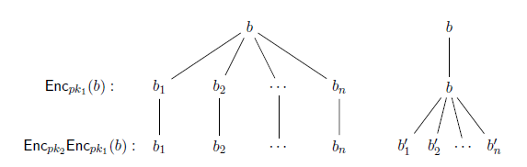

Slide 68


